Slide 1
Machine Learning for Neuroscience
Probability and information theory
Payam Barnaghi
Department of Brain Sciences
Imperial College London
January 2023
Notes:
1

Slide 2
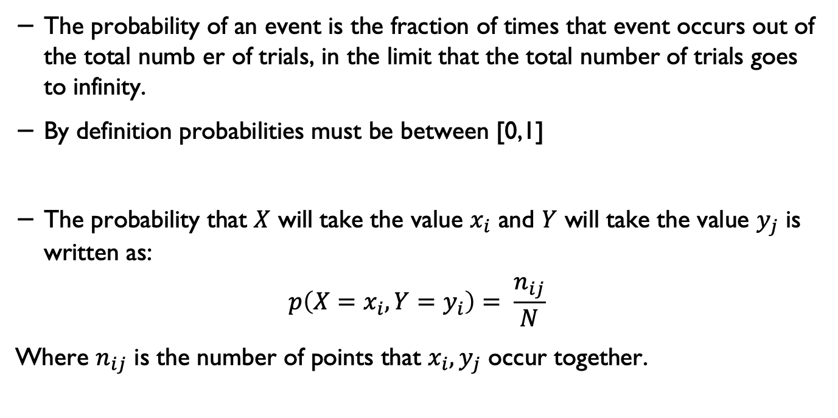
Probability
The probability of an event is the fraction of times that event occurs out of the total numb er of trials, in the limit that the total number of trials goes to infinity.
By definition probabilities must be between [0,1]
The probability that $X$ will take the value $x_{i}$ and $Y$ will take the value $y_{j}$ is written as:
$$p\left(X=x_{i}, Y=y_{i}\right)= \frac{n_{ij}}{N}$$
Where $n_{ij}$ is the number of points that $x_{i},y_{j}$ occur together.

Slide 3
Mathematical notations
In machine learning papers and books you will come across a lot of mathematical notations describing different concepts.
Throughout these series, we will show (some of) the concepts in the mathematical form to help you get more familiar with notations and how to read and interpret them.

Slide 4

Probability
The probability that X takes the value $x_{j}$ irrespective of the value of Y is written as p(x=X)
$$p\left(X=x_{i}\right)= \frac{c_{i}}{N}$$

Slide 5
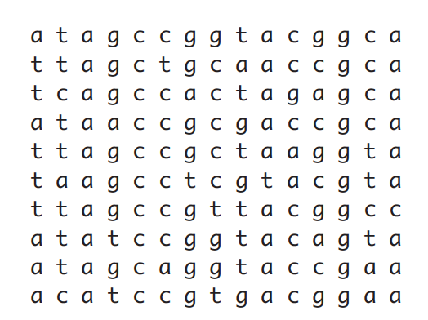
Example

Slide 6
Example- How do you represent these as probability?
Alzheimer's disease is most common in people over the age of 65.
The risk of Alzheimer's disease and other types of dementia increases with age, affecting an estimated 1 in 14 people over the age of 65 and 1 in every 6 people over the age of 80.
But around 1 in every 20 people with Alzheimer's disease are under the age of 65. This is called early- or young-onset Alzheimer's disease.
Data source: NHS, https://www.nhs.uk/conditions/alzheimers-disease/

Slide 7
Random variable
A random variable is a variable that can take on different values randomly.
Random variables may be discrete or continuous. A discrete random variable is one that has a ﬁnite or countably inﬁnite number of states.
Note that these states are not necessarily the integers; they can also just be named states that are not considered to have any numerical value.

Slide 8
Probability distribution
A probability distribution is a description of how likely a random variable or set of random variables is to take on each of its possible states.
The way we describe probability distributions depends on whether the variables are discrete or continuous.

Slide 9
Probability
The expression p(A) denotes the probability that the event A is true.
For example, A might be the logical expression “A patient has Alzheimer’s disease”.
We require that 0 ≤ p(A) ≤ 1,
Where p(A) = 0 means the person definitely does not have the disease, and p(A) = 1 means the patient definitely has the disease.

Slide 10

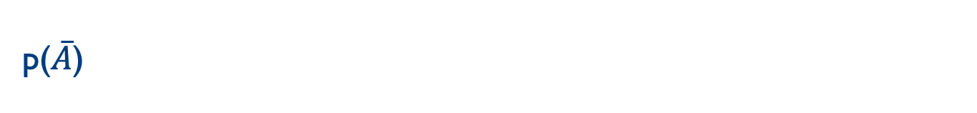
p($\overline{A}$)
We write p($\overline{A}$) to denote the probability of the event not A; this is defined to p($\overline{A}$) = 1 − p(A).
We will often write A = 1 to mean the event A is true, and A = 0 to mean the event A is false.

Slide 11
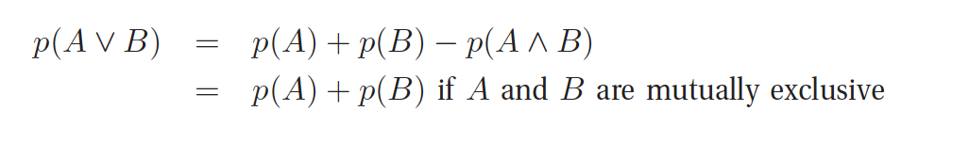
Probability of a union of two events
Given two events, A and B, we define the probability of A or B as follows:
A
B
A
B

Slide 12

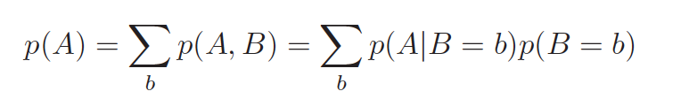
Joint probabilities
This is sometimes called the product rule. Given a joint distribution on two events p(A,B), we define the marginal distribution as follows:

Slide 13
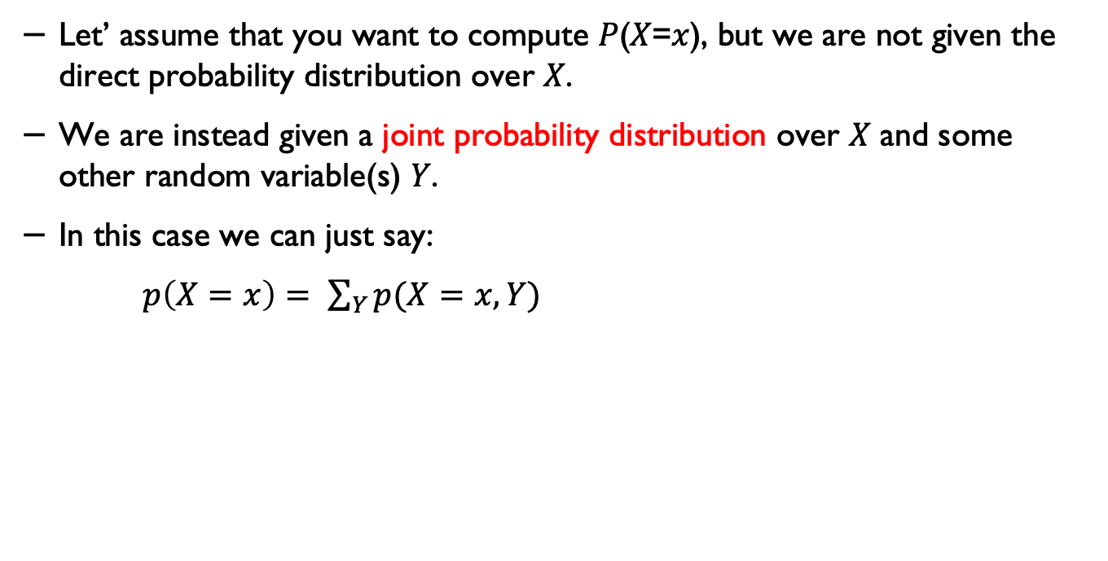
Marginalisation
Let’ assume that you want to compute 𝑃(𝑋=𝑥), but we are not given the direct probability distribution over 𝑋.
We are instead given a joint probability distribution over 𝑋 and some other random variable(s) 𝑌.
In this case we can just say:
$p\left(X=x\right)= \sum_{Y}{p(X=x, Y)}$
Adapted from Rohan Saxena, Quora, https://qr.ae/pvjMYC

Slide 14
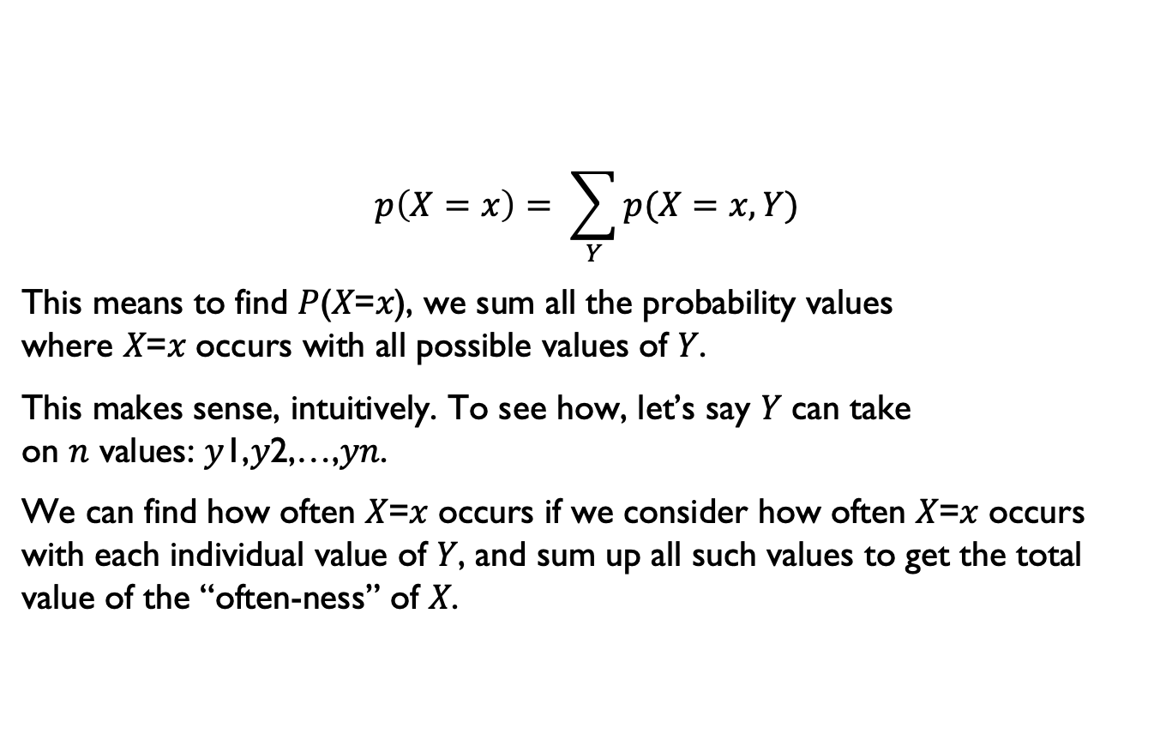
Marginalisation
$$p\left(X=x\right)= \sum_{Y}{p(X=x, Y)}$$
This means to find 𝑃(𝑋=𝑥), we sum all the probability values where 𝑋=𝑥 occurs with all possible values of 𝑌.
This makes sense, intuitively. To see how, let’s say 𝑌 can take on 𝑛 values: 𝑦1,𝑦2,…,𝑦𝑛.
We can find how often 𝑋=𝑥 occurs if we consider how often 𝑋=𝑥 occurs with each individual value of 𝑌, and sum up all such values to get the total value of the “often-ness” of 𝑋.
Adapted from Rohan Saxena, Quora, https://qr.ae/pvjMYC

Slide 15
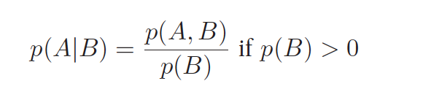
Conditional probability
We define the conditional probability of event A, given that event B is true, as follows:
A
B
p(A,B)

Slide 16
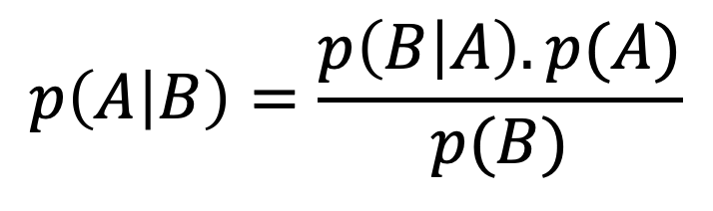
Bayes rule
Likelihood
Prior
Posterior
$$p\left(A | B\right)=\frac{p\left(B | A\right). p(A)}{p(B)}$$
Marginalisation

Slide 17
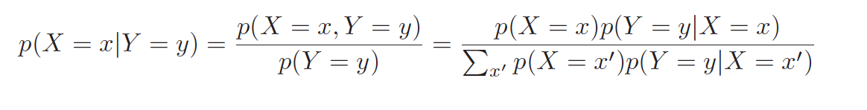
Bayes theorem
Combining the definition of conditional probability with the product and sum rules yields Bayes rule, also called Bayes theorem:

Slide 18
Example: medical diagnosis
As an example of how to use the Bayes rule, consider the following medical diagnosis problem.
Suppose you have a patient who are in their 40s, and you decide to have a medical test for diagnosing AZ disease. If the test is positive, what is the probability of the patient has AZ disease?
That obviously depends on how reliable the test is.

Slide 19


Example: medical diagnosis
Suppose you are told the test has a sensitivity of 80%, which means, if a patient has AD, the test will be positive with probability 0.8.
In other words,
where x = 1 is the test is positive, and y = 1 is the event the patient has AD.
Many people conclude they are therefore 80% likely to have AD. But this is not true! It ignores the prior probability of having AZ, which is quite low:

Slide 20

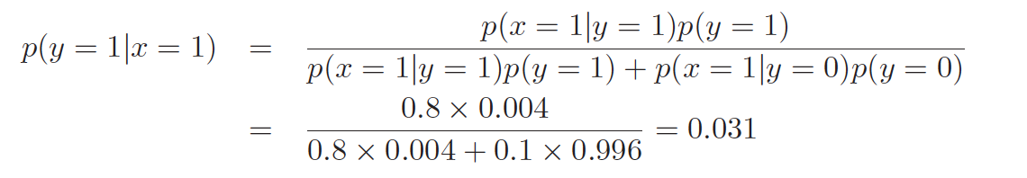
Example: medical diagnosis
Ignoring this prior is called the base rate fallacy. We also need to take into account the fact that the test may be a false positive or false alarm. Unfortunately, such false positives are quite likely (for example due to the screening technology):
Combining these three terms using Bayes rule, we can compute the correct answer as follows:
where p(y = 0) = 1 − p(y = 1) = 0.996. In other words, if the test is positive, the patient has about a 3% chance of having AD.

Slide 21
Example: medical diagnosis

Slide 22
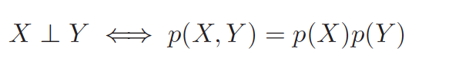
Independence
We say X and Y are unconditionally independent or marginally independent, denoted X ⊥ Y , if we can represent the joint as:
A
B

Slide 23
Probability density function
Consider a dice
0.16
1
2
3
4
5
6

Slide 24
Continuous random variables
So far, we have only considered reasoning about uncertain discrete quantities.
Suppose X is some uncertain continuous quantity. The probability that X lies in any interval a ≤ X ≤ b can be computed as follows.
Let’s define the events A = (X ≤ a), B = (X ≤ b) and W = (a < X ≤ b).
p(W) = p(B) − p(A)
p(B) = p(A) + p(W)

Slide 25
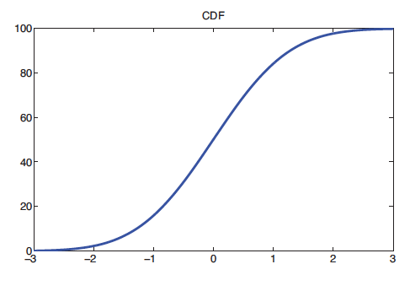

Cumulative Distribution Function (cdf)
Define the function $F\left(q\right)≜p(x≤q)$. This is called the cumulative distribution function or cdf of X.
p(a < X ≤ b) = F(b) − F(a)

Slide 26
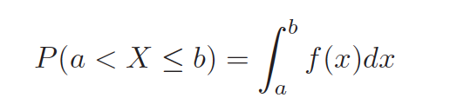

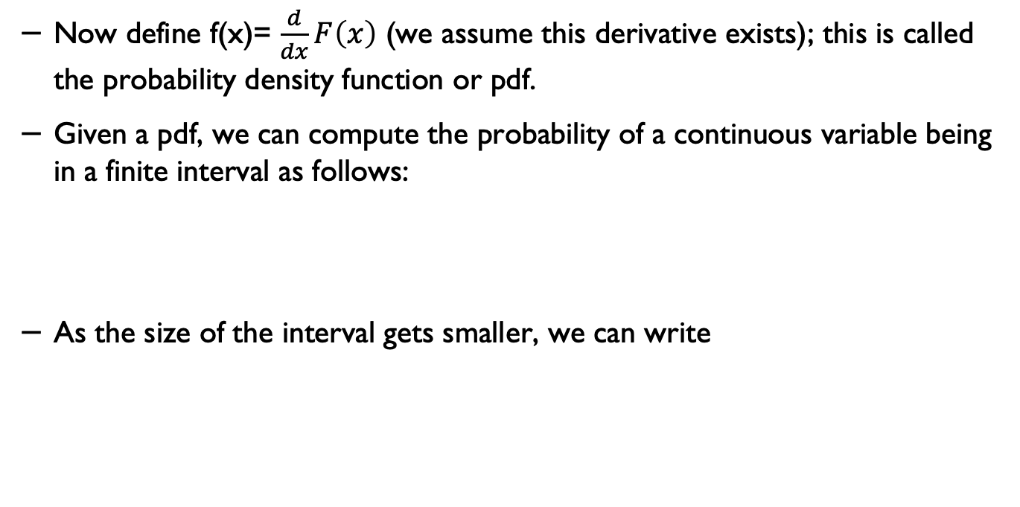
Probability Density Function*
Now define f(x)= $\frac{d}{dx}F\left(x\right)$ (we assume this derivative exists); this is called the probability density function or pdf.
Given a pdf, we can compute the probability of a continuous variable being in a finite interval as follows:
As the size of the interval gets smaller, we can write

Slide 27
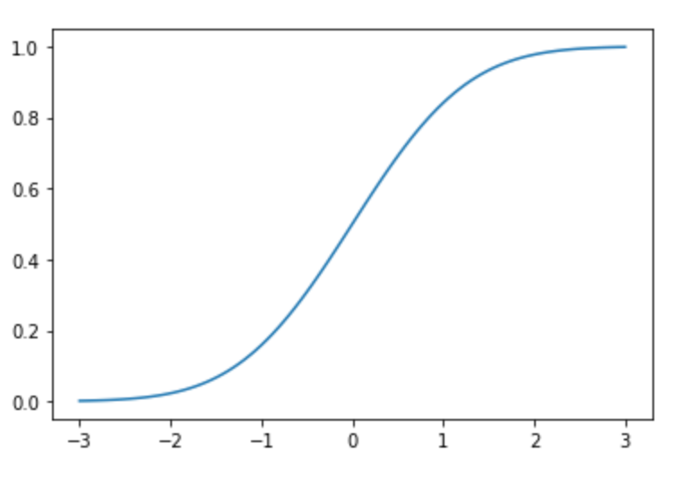
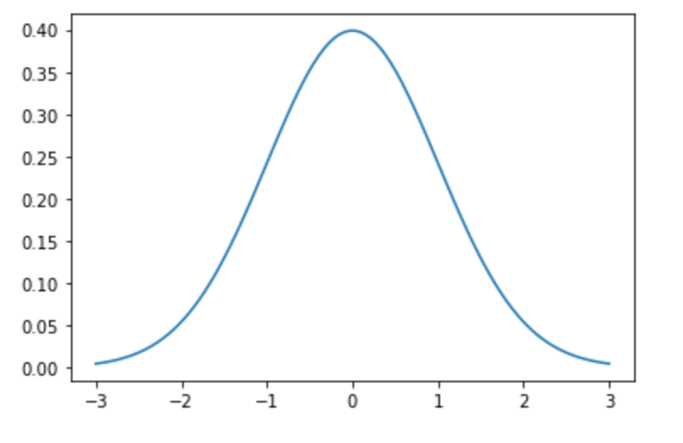

Probability Density Function vs Cumulative Distribution Function
Code: PDF_CDF.ipynb

Slide 28
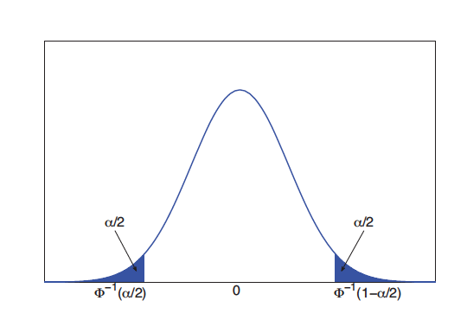
pdf for the standard normal
Corresponding pdf for a Gaussian distribution. The shaded regions each contain α/2 of the probability mass. Therefore the nonshaded region contains 1 − α of the probability mass.

Slide 29


Mean
The most familiar property of a distribution is its mean, or expected value, denoted by μ.
For discrete random variable, it is defined as:
and for continuous random variables, it is defined as

Slide 30
Example: Expected value

Slide 31

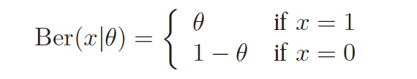
Bernoulli
Suppose we toss a coin only once. Let X ∈ {0, 1} be a binary random variable, with probability of “success” or “heads” of θ.
We say that X has a Bernoulli distribution. This is written as X ∼ Ber(θ), where the pmf is defined as

Slide 32
Binomial distribution
Suppose we toss a coin n times. Let X ∈ {0, . . . , n} be the number of heads. If the probability of heads is θ, then we say X has a binomial distribution, written as X ∼ Bin(n, θ).

Slide 33
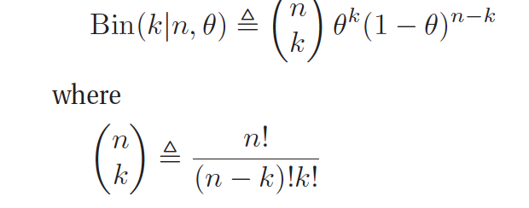

Binomial distribution
If we toss a coin n times and want to determine the probability of k heads (probability of a head is θ).
$$and n!=n ∗\left(n−1\right) ∗\left(n−2\right)∗ …∗1$$

Slide 34
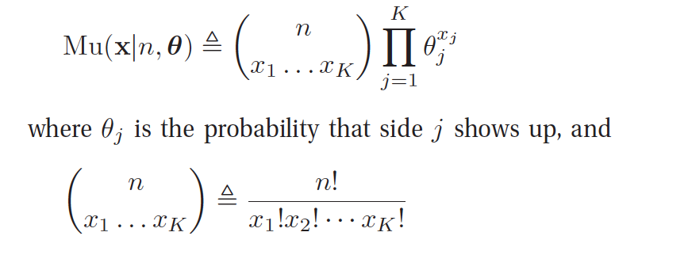
The multinomial and multinoulli distributions*
The binomial distribution can be used to model the outcomes of coin tosses. To model the outcomes of tossing a K-sided die, we can use the multinomial distribution.
This is defined as follows: let x = (x₁, . . . , x_{K}) be a random vector, where x_{j} is the number of times side j of the die occurs.

Slide 35
Application: DNA sequence

Slide 36
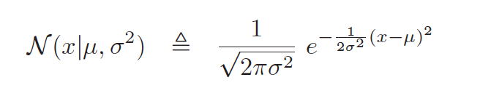
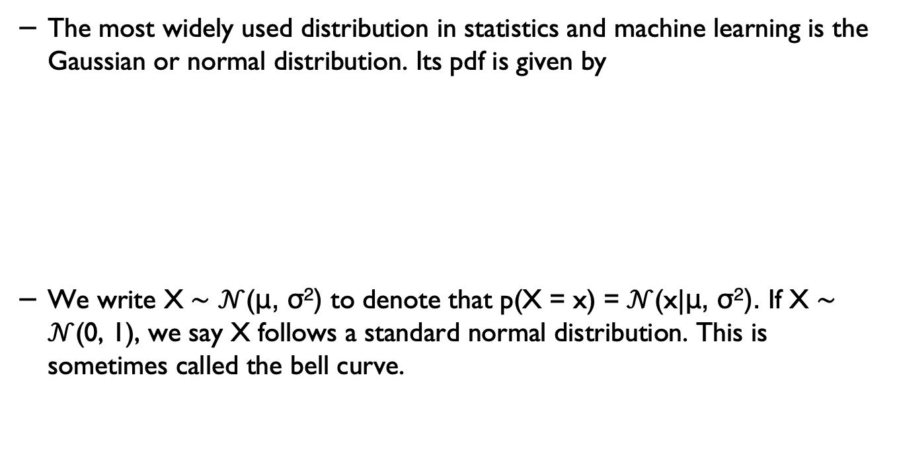
Gaussian (normal) distribution
The most widely used distribution in statistics and machine learning is the Gaussian or normal distribution. Its pdf is given by
We write X ∼ $𝒩$(μ, σ²) to denote that p(X = x) = $𝒩$(x|μ, σ²). If X ∼ $𝒩$(0, 1), we say X follows a standard normal distribution. This is sometimes called the bell curve.

Slide 37
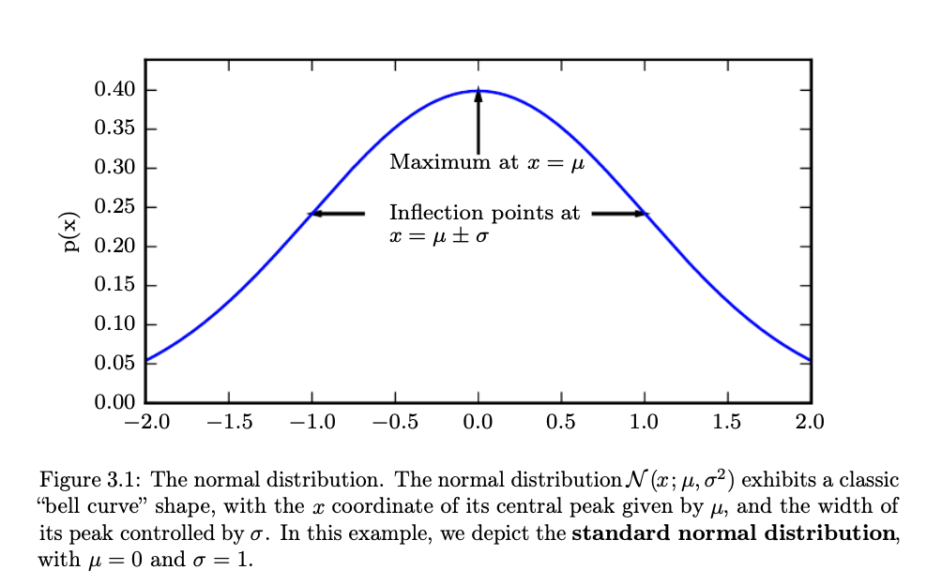
The standard normal distribution
Source: Goodfellow et al., Deep Learning, MIT Press, https://www.deeplearningbook.org/contents/prob.html

Slide 38
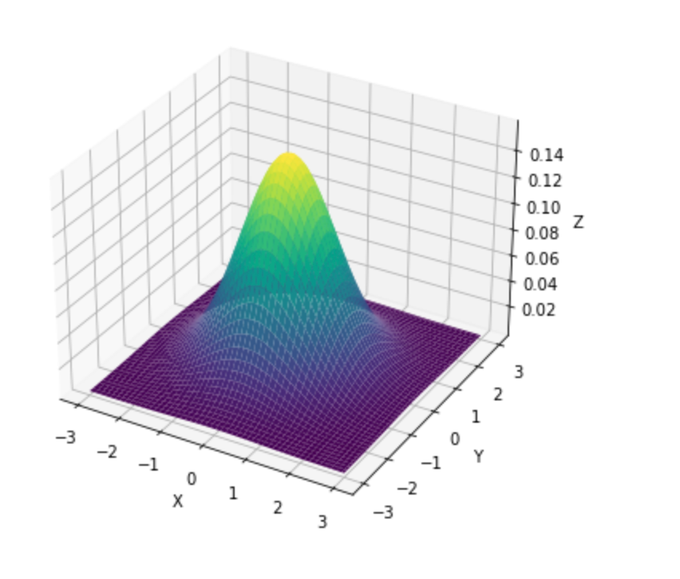
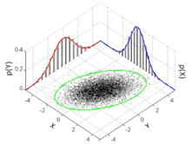
Multivariate Gaussian
Source: https://commons.wikimedia.org/wiki/File:MultivariateNormal.png

Slide 39
Information Theory
The basic intuition behind information theory is that learning that an unlikely event has occurred is more informative than learning that a likely event has occurred.
Likely events should have low information content, and in the extreme case, events that are guaranteed to happen should have no information content whatsoever.
Less likely events should have higher information content.

Slide 40
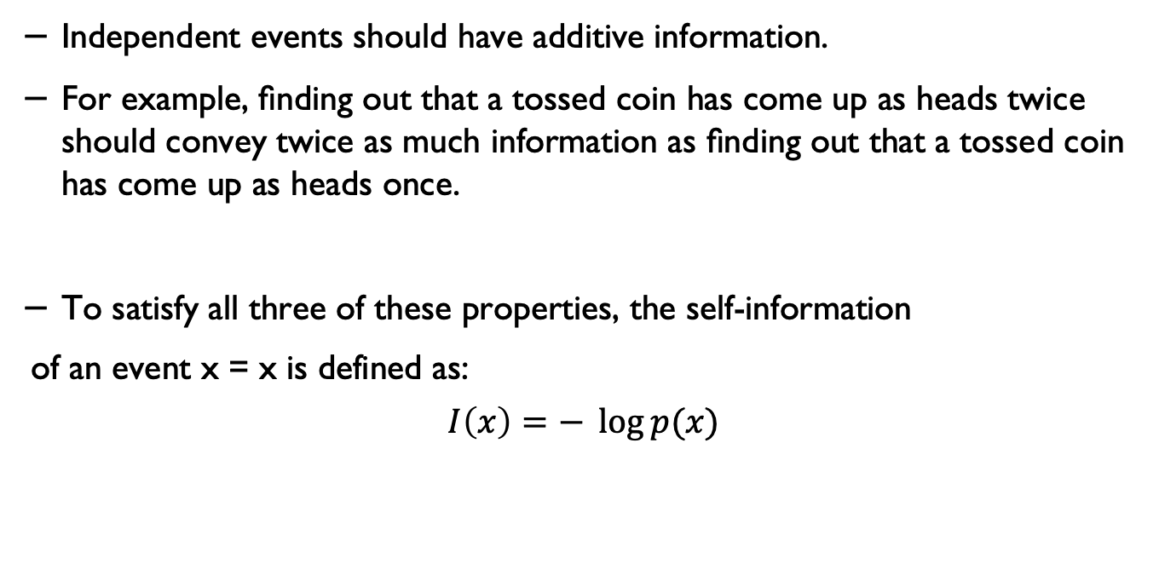
Information Theory
Independent events should have additive information.
For example, ﬁnding out that a tossed coin has come up as heads twice should convey twice as much information as ﬁnding out that a tossed coin has come up as heads once.
To satisfy all three of these properties, the self-information
of an event x = x is defined as:
$$I\left(x\right)=− \log{p(x)}$$

Slide 41
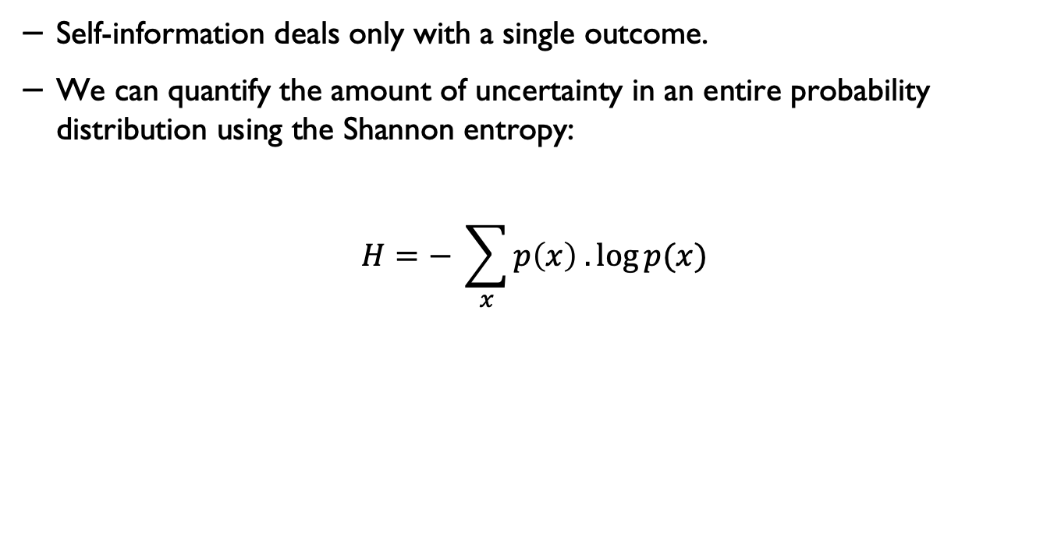
Shannon's entropy
Self-information deals only with a single outcome.
We can quantify the amount of uncertainty in an entire probability distribution using the Shannon entropy:
$$H=− \sum_{x}{p\left(x\right) . \log{p(x)}}$$

Slide 42
Example 1
Calculate the entropy of tossing a fair coin.
Notes:
The entropy of the unknown result of the next toss of the coin is maximized if the coin is fair (that is, if heads and tails both have equal probability 1/2). This is the situation of maximum uncertainty as it is most difficult to predict the outcome of the next toss; the result of each toss of the coin delivers one full bit of information. This is because
H(X)=−∑i=1np(xi)logb⁡p(xi)=−∑i=1212log2⁡12=−∑i=1212⋅(−1)=1
(source Wikipedia)

Slide 43
Example 2
Calculate the entropy of tossing an unfair coin (p(H) =0.3, p(T)=0.7).

Slide 44
Example 3
Calculate the entropy of each of these sequences (with the given data).

Slide 45
Conditional independence
Suppose we assume that x_{t+1} is independent from x_{1:t-1}
In words, “the future is independent of the past given the present”.
This is called the (first order) Markov assumption.

Slide 46
Markov chains
A
B

Slide 47
Behaviour modelling using MC
Imagine each activity/behaviour state is modelled as a Markov chain state.
Identify the transitions.
Determine the probability of being in each state and the probability of transitioning between the states.
You can use this information to build a Markov Chain model.
You can use the chain probability rule to calculate the probability of being at a current state given an earlier observation.

Slide 48
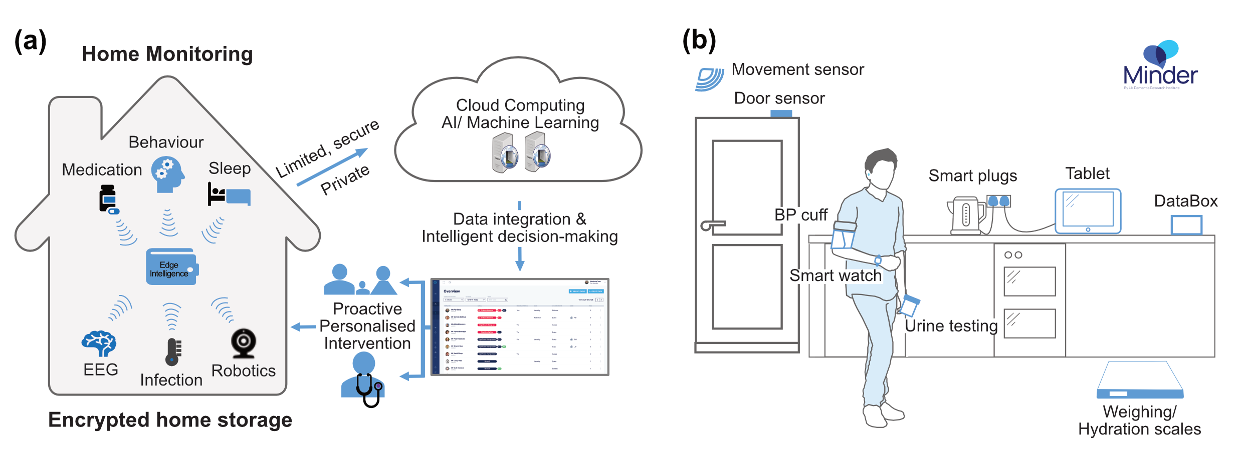
Example – daily activity monitoring

Slide 49
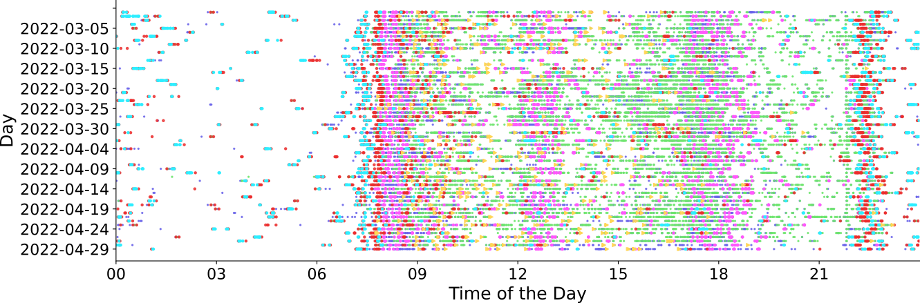
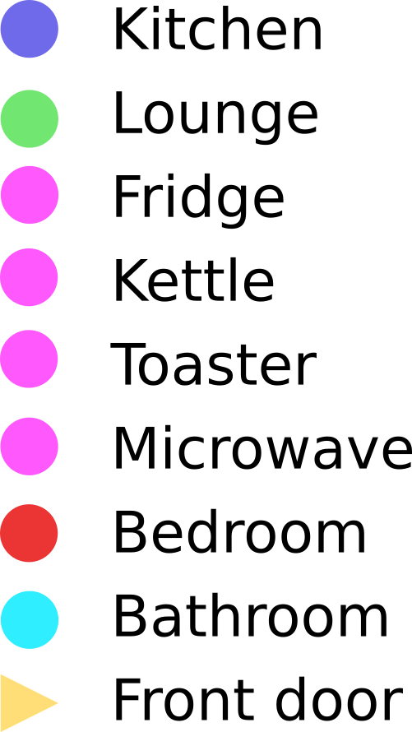
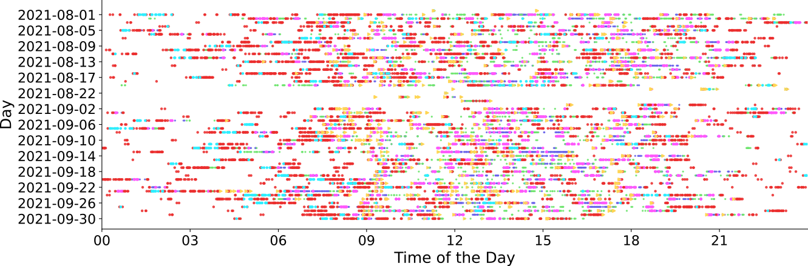
Continuous remote monitoring – activity data

Slide 50
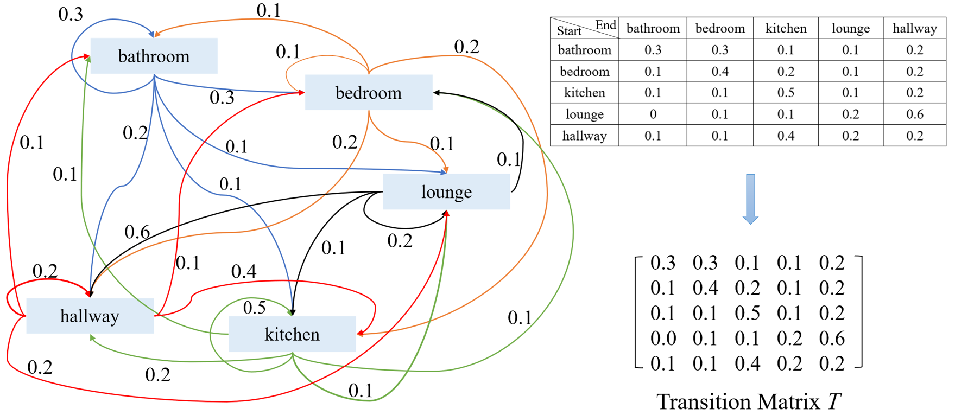
Changes in activity patterns
For more information see: https://arxiv.org/abs/2210.01736

Slide 51
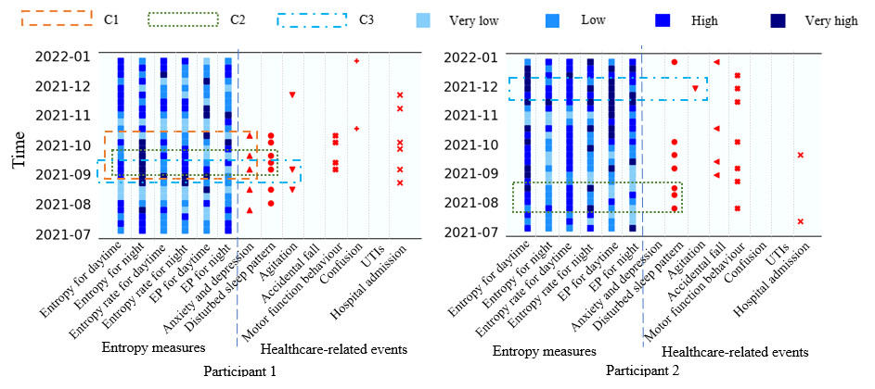
Measuring changes in activity patterns
For more information see: https://arxiv.org/abs/2210.01736

Slide 52
Review questions

Slide 53
Q1. Entropy
Let’s assume we build a Markov chain and then measure the entropy in activity states of a patient at home over time.
If the patient’s activity suddenly reduces over time, will the entropy decrease or increase?

Slide 54
Q2. Overfitting
If we have more features than the number of training samples, there is risk to overfit the model.
True or False?

Slide 55
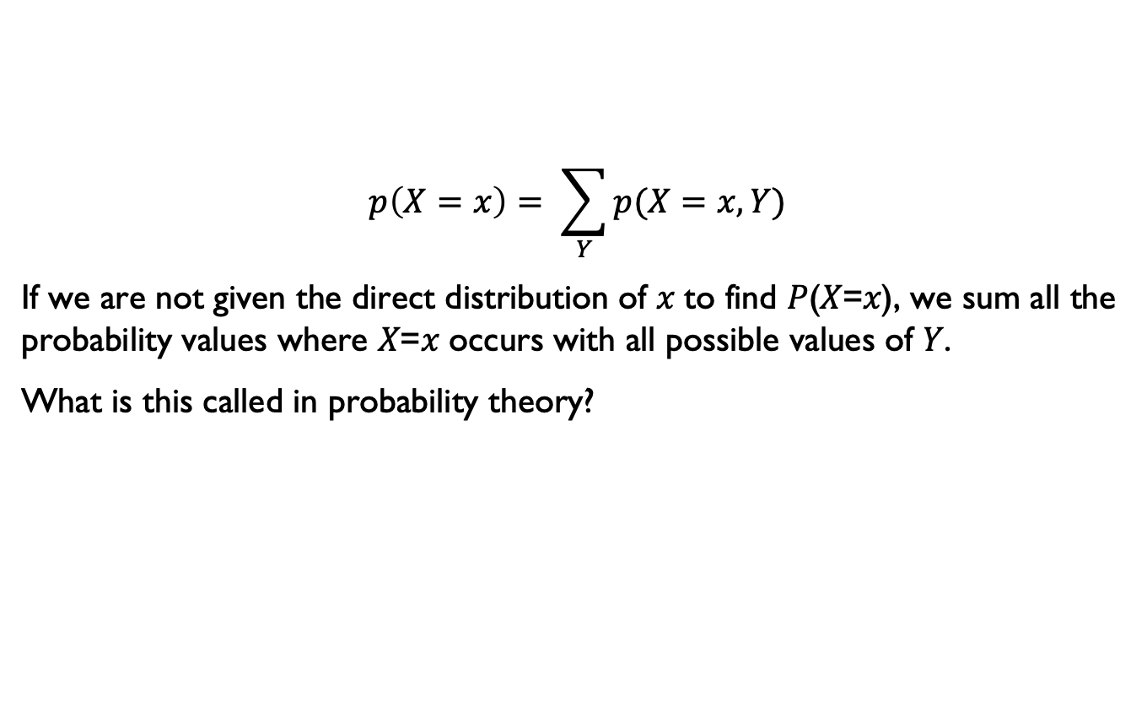
Q3. Probability
$$p\left(X=x\right)= \sum_{Y}{p(X=x, Y)}$$
If we are not given the direct distribution of 𝑥 to find 𝑃(𝑋=𝑥), we sum all the probability values where 𝑋=𝑥 occurs with all possible values of 𝑌.
What is this called in probability theory?

Slide 56
Acknowledgement
Several slides in this lecture are adapted from Kevin Murphy’s book:
Machine Learning: A Probabilistic Perspective Kevin P. Murphy, MIT Press.

Slide 57
If you have any questions
Please feel free to come and see me (9th Floor, Sir Michael Uren Research Hub, White City Campus) or email (p.barnaghi@imperial.ac.uk).

